Slide 1
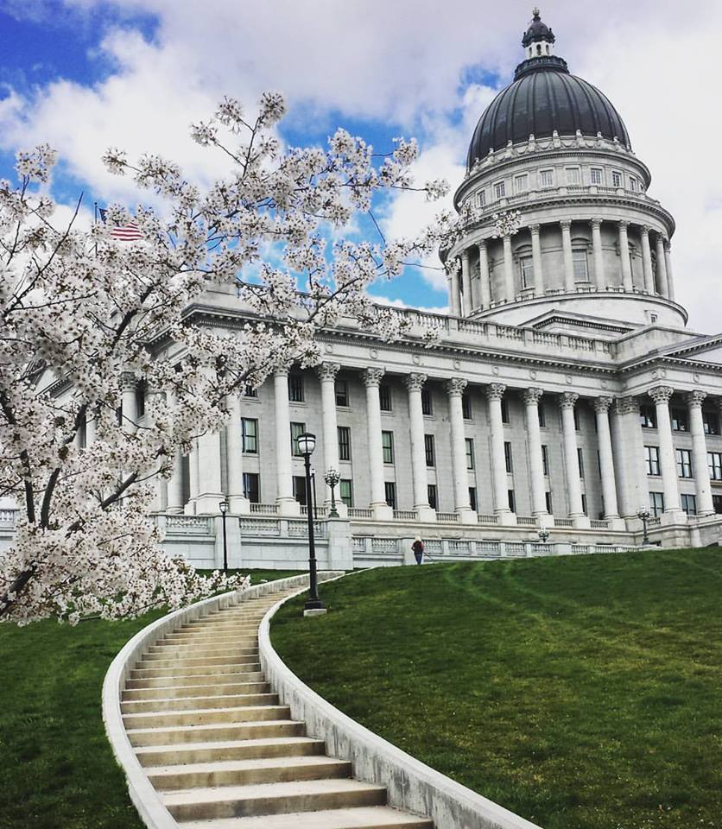
WELCOME TO UTAH LEGISLATIVE DAY! Jan. 31, 2024
Advocacy Pillar Members:
Gina R. Ward, MS, RDN, CDCES
Nica Clark, PhD, RD
Jeremiah McGuire, MA, RDN, ACE-CPT
Dani Perez, RDN & Heidi Wengreen, RD

Slide 2
What does it mean to be an advocate?
speak, plead, or argue in favor of As a noun, an advocate is a person who represents another person's interests, like a lawyer does. In fact, the word comes from the courtroom — it's from Latin advocare, to “add” a “voice.” To advocate is to add a voice of support to a cause or person.

Slide 3
Utah Affiliate operates under the direction of the Academy of Nutrition & Dietetics. https://compacts.csg.org/compact-updates/the-interstate-compact-for-dietitians/
Dietitian Interstate Compact
Standardize licensure requirements (Model Practice Agreement)

Slide 5
Consistent, clear messaging is the key to success. Educate dietitians on advocacy efforts. Dietitians then educate legislators, who sponsor legislation.

Slide 6
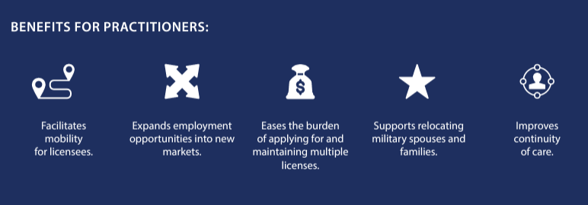

Slide 8
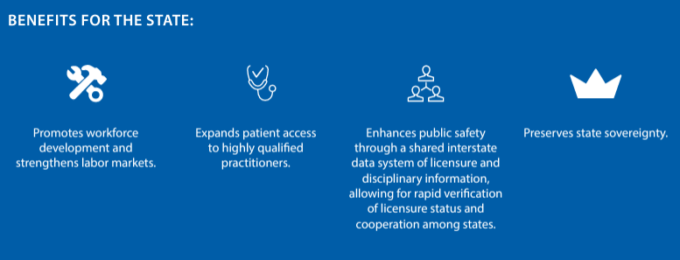

Slide 9
Why Support the Dietitian Compact?
A senator or house rep must sponsor the Dietitian Compact. UAND leadership meets with legislators and asks them to sponsor legislation. We have to “SELL” the reason the bill is needed. HOW does this benefit Utah? Educate the legislators.

Slide 10
Plan at most a FOUR-MINUTE PITCH.
1. ASK for what you want (sponsor the legislation)
2. Give examples of WHY the legislation is needed
3. ASK for what you want again (Clear and concise)
REQUEST A MEETING WITH YOUR LEGISLATOR. If you’re lucky, you’ll get 15-30 minutes.

Slide 11
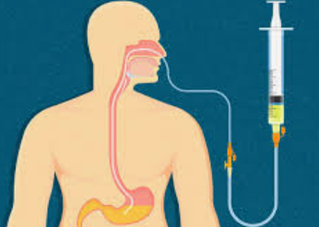
Nutritionists vs. Registered Dietitians
Nutritionist Training
No mandated requirements
Little to no education
No accreditation
Cannot provide Medical Nutrition Therapy
Registered Dietitian (RD)
Masters degree in Dietetics
1-year Dietetic Internship
Pass licensure exam Commission of Dietetic Registration (CDR)
75 hours continuing education/5 years or retake licensure exam
Provide Medical Nutrition Therapy (MNT) including nutrition support (TPN, tube feedings, etc.)
50% of all RDs hold a Masters degree!

Slide 14
Plan at most a FOUR-MINUTE PITCH.
1. ASK for what you want (sponsor the legislation)
2. Give examples of WHY the legislation is needed
3. ASK for what you want again (Clear and concise)
YOU WILL NEED EXAMPLES AND STORIES TO “SELL” THE NEED FOR YOUR “ASK.”

Slide 15
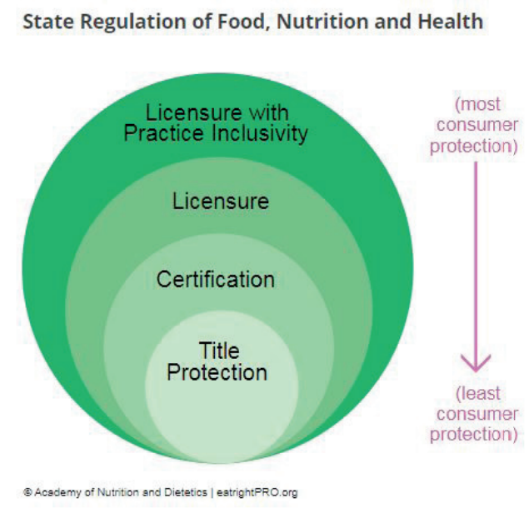
Dietetics Terminology for State Regulations
LICENSURE defines specific requirements individuals must meet to obtain a license to provide services within a defined scope of practice and regulates the practice.
Licensure w/Practice Inclusivity limits the ability of unlicensed individuals (i.e. health coaches) to provide services within the defined scope of practice for the regulated profession.

Slide 16
Dietetics Terminology for State Regulations
Certification (current status in Utah)
Individuals with specified credentials (Registered Dietitian, RD) are qualified to practice dietetics.
DOPL ensures those individuals are held to established standards of practice.
Certification includes title protection (RD) but not practice exclusivity, meaning uncertified individuals can still practice the regulated profession.

Slide 17
HOW LICENSURE BENEFITS UTAHNS
Access to qualified nutrition professionals
State standards help consumers FIND RDN
Protects Public Safety from incompetent individuals
ASSURES PUBLIC, health insurance, government of RDN competence
RDN MUST COMPLY WITH LAWS TO RECEIVE REIMBURSEMENT FOR SERVICES.
OPEN UP PROFESSIONAL Opportunities (CONFIDENCE W/OVERSIGHT)

Slide 18
Go to https://le.utah.gov/ and find your elected officials in the Senate and the House. Learn what committees they serve on and what is important to them. (HOMEWORK)

Slide 19
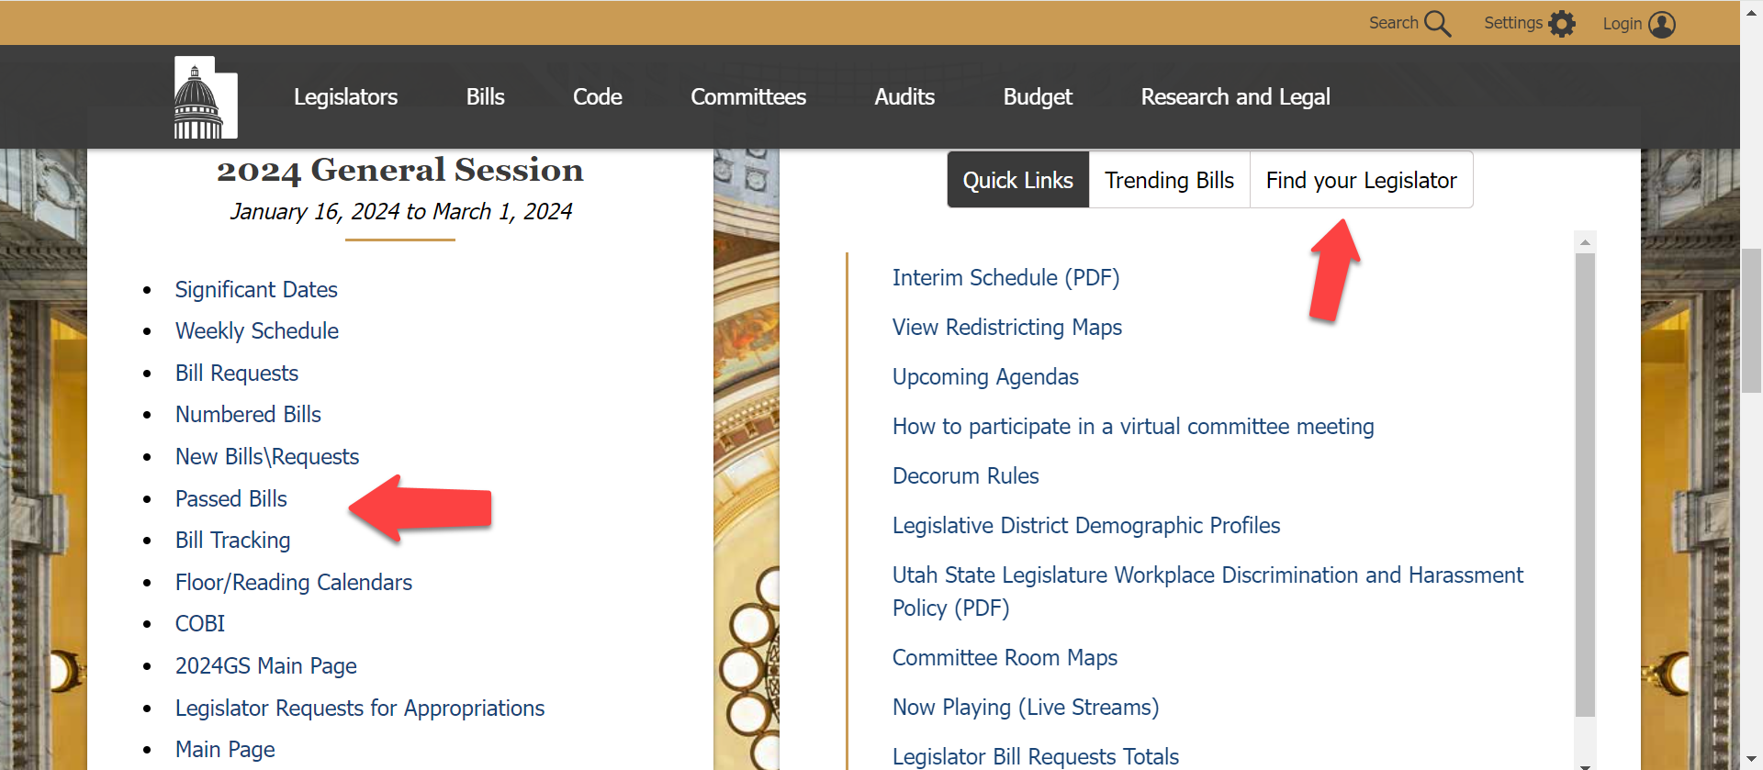
During a legislative session, there are lots of active links. You can track a bill (sign up for alerts), find your legislator, etc.

Slide 20
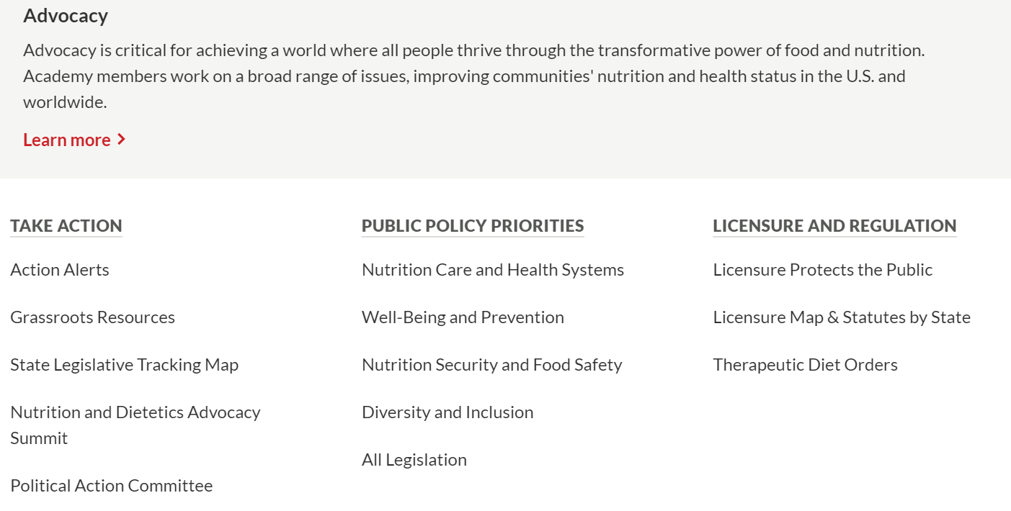

Slide 21
Sign up for affinity groups that interest you
MNT Expansion Affinity Group Meets the first Tuesday of every month 3:30-4:30 pm EST
Nutrition Security Affinity Group Meets the first Wednesday of every month from 4-5 pm EST
Licensure Initiatives Affinity Group Meets the second Tuesday of every month 3-4 pm EST
Reimbursement & Payment Affinity Group Meets the fourth Tuesday of every month from 2-3 pm EST

Slide 22
UAND CONF. April 19-20, 2024
Advocacy Panel presentation will provide an update for advocacy efforts nationwide and in Utah, presenting our grassroots advocacy plan for 2024-2025.
LEGISLATIVE DAY Feb. 12, 2025 (Wednesday) 7-9 AM
Executive Board voted 01/10/2024 to delay legislative breakfast (State Capitol Rotunda) until next year. We hope RD licensure legislation will be on the agenda next year – didn’t quite make it this year.

Slide 23
Nica Clark, PhD, RD (435) 592-5135 nica.clark@utahtech.edu Gina R. Ward, MS, RDN, CDCES (801) 726-0082 ginaward9819@MSN.COM Jeremiah McGuire, MA, RDN, ACE-CPT (918) 804-3929 jeremiah.mcguire@utah.edu
Advocate for Your Profession!

